Slide 1
Lecture #3
Pointers:
A Quick Review of Pointers
Dynamic Memory Allocation
Resource Management Part 1:
Copy Constructors
If you feel uncomfortable with pointers, then study and become an expert before our next class!
(Yeah right… like you’re gonna review on your own)

Slide 2
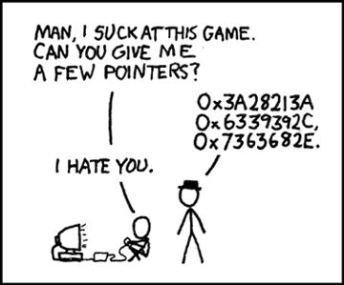
Pointers

Slide 3



Addresses and Pointers… What’s the big picture?
We use pointers to efficiently access/modify variables defined in other parts of our program.
Just like every house has a street address, every variable has a memory address.
…
The grade variable has an address of 1024 in RAM
00001023
00001024
00001025
00001026
00001027
00001028
00001029
00001030
void someFunction()
{
char grade = ‘B’;
…
}
grade
‘B’
1024
ptr
The ptr variable holds the address of the grade variable
char *ptr = &grade;
Uses:
Pointers are used in all C++ programs to efficiently pass parameters, and to refer to dynamic variables.
…
A pointer is simply a variable that holds another variable’s address!
Notes:
We use pointers to efficiently access/modify variables defined in other parts of our program.

Slide 4
Every Variable Has An Address
00000000
00000001
Every time you define a variable in your program, the compiler finds an unused address in memory and reserves one or more bytes there to store it.
…
00001000
00001001
00001002
00001003
00001004
00001005
00001006
00001007
00001008
00001009
00001010
00001011
Important: The address of a variable is defined to be the lowest address in memory where the variable is stored.
So, what is age’s address in memory?
age
What about grade’s address?
41
int main()
{
int age = 41;
char grade = ‘B’;
...
}
grade
66
…
99999990
99999991
99999992

Slide 5
Getting the Address of a Variable
We can get the address of a variable using C++’s & operator.
00000000
00000001
…
If you place an & before a variable in a program statement, it means “give me the numerical address of the variable.”
00001000
00001001
00001002
00001003
00001004
00001005
00001006
00001007
00001008
00001009
00001010
00001011
Output:
age’s address: 1006
age
grade’s address: 1011
41
int main()
{
int age = 41;
char grade = ‘B’;
}
cout << “age’s address: “<< &age ;
cout << “grade’s address: “ << &grade ;
grade
66
…
99999990
99999991
99999992

Slide 6
Ok, So What’s a Pointer?
pointer variable
I’m a regular variable… and I hold a regular value!
A pointer is a special kind of variable that holds another variable’s address instead of a regular value.
...
00001000
00001002
00001004
00001006
00001008
00001010
00001012
00001014
...
Here’s how we define a pointer variable! The * means pointer.
Here’s how we define a regular variable!
idontknow
42
void foo()
{
}
Another way to say this is:
“p points to address 1000”
int idontknow; idontknow = 42;
“Variable p is a
p
pointer to
1000
an int variable.”
I’m a pointer variable… and all I can hold are the addresses of other variables!
For instance, right now I hold a value of 1000, the address of the “idontknow” variable.
int *p;
To understand the type of your pointer variable, simply read your declaration from right to left…
p = &idontknow;

Slide 7
What do I do with Pointers?
Question: So I have a pointer variable that points to another variable… now what?
Answer: You can use your pointer and the star operator to read/write the other variable.
I just changed idontknow’s value to 5…
...
00001000
00001002
00001004
00001006
00001008
00001010
00001012
00001014
...
void foo()
{
}
idontknow
42
42
“Get the address value stored in the p variable…
Then go to that address in memory…
and give me the value stored there.”
void foo()
{
}
int idontknow; idontknow = 42;
“Get the address value stored in the p variable…
Then go to that address in memory…
and store a value of 5 there.”
int idontknow; idontknow = 42;
p
1000
1000
…without ever referring to its variable name!
1000
int *p;
p = &idontknow;
int *p;
cout << *p;
cout << *p → cout << *1000 → cout << 42
1000;
p = &idontknow;
*p = 5 → *1000 = 5
1000
*p = 5;
5

Slide 8
Another Pointer Example
void set(int *px)
{
*px = 5;
}
int main()
{
int x = 1;
set(&x);
cout << x;
}
00000000
00000001
…
“Store a value of 5 at location .”
x
00009240
00009241
00009242
00009243
00009244
00009245
00009246
00009247
00009248
00009249
00009250
1
5
px
9240
9240
9240
// prints 5
Let’s use pointers to modify a variable inside of another function.
Cool – that works! We can use pointers to modify variables from other functions!

Slide 9
What if We Didn’t Use Pointers?
void set(int *px)
{
*px = 5;
}
int main()
{
int x = 1;
set(&x);
cout << x;
}
Now what would happen if we didn’t use pointers in our code?
00000000
00000001
…
x
00009240
00009241
00009242
00009243
00009244
00009245
00009246
00009247
00009248
00009249
00009250
1
1
// prints 1
px
5
Oh no! We tried to change the value of x in set but it only changed the local variable!
1
Had we used a pointer, it would have worked!

Slide 10
Pointers vs References
Since the set function accepts a reference…
Since val points to our original variable, x, this line actually changes x!
When you pass a variable by reference to a function, what really happens?
00000000
00000001
…
x
00009240
00009241
00009242
00009243
00009244
00009245
00009246
00009247
00009248
00009249
00009250
void set(int &val) // val is a ref
{
val = 5;
}
int main()
{
int x = 1;
set(x);
cout << x;
}
1
5
It looks like we’re just passing the value of x, but in fact…
This line is really passing the address of variable x to set…
val
9240
9240
In fact, a reference is just a simpler notation for passing by a pointer!
(Under the hood, C++ uses a pointer)

Slide 11
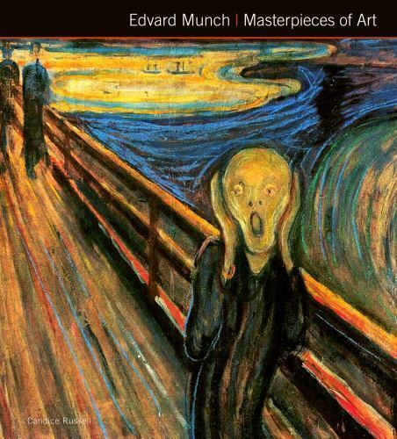
Pointers are Dangerous!
Or it could point at a critical variable! (But not the one you want!)
You must always explicitly set the value of a pointer variable or you’ll be sorry! ☹
00000000
00000004
int main()
{
double bank_balance = 325.50; // $$
double college_debt = 5000; // $$
…
double *ptr_to_debt;
*ptr_to_debt = 0; // Set debt to $0!!
}
…
So what address does our pointer hold?
00009240
00009244
00009248
00009252
00009256
00009260
00009264
00009268
00009272
00009276
00009280
bank_balance
300.50
But what would happen if we accidentally deleted or just forgot this line?
It’s random!!
Here we properly set our pointer so it holds the address of our college debt variable…
college_debt
5000
= nullptr;
nullptr
ptr_to_debt
52375
9240
ptr_to_debt = &college_debt;
??????
CRASH!
0
It might point at an empty slot of memory...
before using the pointer to change our debt to zero!
Pro tip: Always initialize pointers to nullptr immediately when you define them!
Why? If you use * on a null pointer, your program will crash immediately and you’ll find the bug ASAP!

Slide 12
Class Challenge
Write a function called swap that accepts two pointers to integers and swaps the two values pointed to by the pointers.
int main()
{
int a=5, b=6;
swap(&a, &b);
cout << a; // prints 6;
cout << b; // prints 5
}
Hint: Make sure that every time you define a pointer variable you immediately set its value to a valid address!!!

Slide 13
Class Challenge Solution
Get the value stored at location 9240…
and put it in temp.
Get the value stored in temp and store it in location 9244…
And put it into location 9240.
Get the value stored at location 9244…
void swap (int *pa, int *pb)
{
int temp;
temp = *pa;
*pa = *pb;
*pb = temp;
}
int main()
{
int a=5, b=6;
swap(&a,&b);
cout << a;
cout << b;
}
00000000
00000001
…
a
00009240
00009242
00009244
00009246
00009248
00009250
00009252
00009254
00009256
00009258
00009260
5
5
b
6
6
9240, 9244
9240
9244
pa
9240
pb
9244
temp
-23

Slide 14
Wrong Challenge Solution #1
And put it in location 50000!
Get the value stored at location 9240…
Problem: In this solution, we use a pointer without first pointing it at a variable!
void swap (int *pa, int *pb)
{
int *temp;
*temp = *pa;
*pa = *pb;
*pb = *temp;
}
int main()
{
int a=5, b=6;
swap(&a,&b);
cout << a;
cout << b;
}
00000000
00000001
…
a
00009240
00009242
00009244
00009246
00009248
00009250
00009252
00009254
00009256
00009258
00009260
5
5
b
6
9240, 9244
9240
9244
pa
9240
CRASH!
pb
9244
temp
50000

Slide 15
Wrong Challenge Solution #2
void swap (int *pa, int *pb)
{
int *temp;
temp = pa;
pa = pb;
pb = temp;
}
int main()
{
int a=5, b=6;
swap(&a,&b);
cout << a;
cout << b;
}
Problem: In this solution, we swap the pointers but not the values they point to!
00000000
00000001
…
a
00009240
00009242
00009244
00009246
00009248
00009250
00009252
00009254
00009256
00009258
00009260
5
b
6
9240, 9244
9240
9244
// prints 5
pa
9240
// prints 6
9240
pb
9244
9244
temp
9240
50000

Slide 16
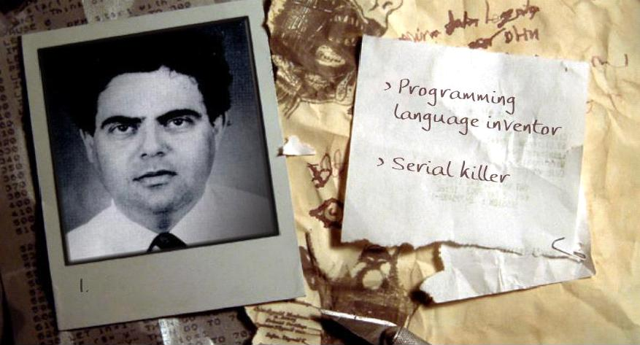
Let’s Play….
Programming Language Inventor
Or
Serial Killer
See if you can guess who uses a keyboard and who uses a chainsaw!
Bertrand Meyer: invented eiffel programming language
Notes:
Bertrand Meyer: invented eiffel programming language

Slide 17
Arrays, Addresses and Pointers
nums is just an array.
It holds three regular integer values.
But it doesn’t hold an address like a pointer variable, so it’s not a pointer!
And here’s how to make a pointer point to an array…
Just like any other variable, every array has an address in memory.
Question: So is “nums” an address or a pointer or what?
But… in C++ you don’t use the & operator to get an array’s address!
Answer: “nums” is just an array. But C++ lets you get its address without using the & so it looks like a pointer…
You simply write the array’s name (without brackets) and C++ will give you the array’s address!
…
00009240
00009242
00009244
00009246
00009248
00009250
00009252
00009254
00009256
00009258
00009260
ptr is a pointer variable.
Why? Because it’s a variable that holds an address value!
nums
9242
10
9242
int main()
{
int nums[3] = {10,20,30};
}
[0]
[1]
20
cout << nums;
// prints 9242
[2]
30
int *ptr = nums; // pointer to array
ptr

Slide 18
Arrays, Addresses and Pointers
NOTE: when we say “skip down j elements,” we don’t just mean “skip down j bytes!”
Instead we mean, skip over j of the actual elements/values in the array (e.g., skip over the values 10 and 20 to get to 30)
In C++, a pointer to an array can be used just as if it were an array itself!
In C++, the two syntaxes have identical behavior:
Or you can use the * operator with your pointer to access the array’s contents.
ptr[j] *(ptr + j)
They both mean: “Get the value in ptr, and go to that address in memory, then skip down j elements and get the value.”
They both mean: “Get the value in ptr, and go to that address in memory, then skip down j elements and get the value.”
They both mean: “Get the value in ptr, and go to that address in memory then skip down j elements and get the value.”
This line says “print out the item that is two elements down from where ptr points.” (in this case, ptr points to the top of the array) It’s the same as printing out nums[2] or ptr[2].
Since ptr points to the top of the nums array, this prints out the value that is two integer elements from the top of the nums array.
…
Since ptr points to the top of the nums array, this prints out the value that is at address 9242 – i.e., the first element of the nums array.
00009240
00009242
00009244
00009246
00009248
00009250
00009252
00009254
00009256
00009258
00009260
nums
int main()
{
int nums[3] = {10,20,30};
}
[0]
10
[1]
20
int *ptr = nums; // pointer to array
[2]
30
cout << ptr[2];
// prints nums[2] or 30
cout << *ptr;
// prints nums[0] or 10
ptr
cout << *(ptr+2);
// prints nums[2] or 30
9242

Slide 19
Pointer Arithmetic and Arrays
The array parameter variable is actually a pointer!
You can use [ ] syntax if you like but it’s REALLY a pointer!
This line prints the element that is one item from the top.
Since array starts at 3000, and each item is an integer, our next integer is at 3004…
Did you know that when you pass an array to a function…
This line prints the element that is zero items
from the top of where ‘array’ points to.
array
int *array
You’re really just passing the address to the start of the array!
void printData(int array[ ])
{
cout << array[0] << “\n”;
cout << array[1] << “\n”;
}
Here we’re passing the address of the second element of the array.
Since nums[0] is at address 3000, nums[1] is 4 bytes down at 3004.
… not the array itself!
int main()
{
int nums[3] = {10,20,30};
printData(nums);
printData(&nums[1]);
printData(nums+1);
}
array
nums
3000
3000
3004
3008
[0]
10
20
30
10
3004
[1]
20
[2]

Slide 20
Pointer Arithmetic and Arrays
Our printData function thinks the array actually starts at location 3004!
It knows nothing about the earlier part of the array!
This prints the element that’s zero items from the top of where our array starts…
i.e., the item at location 3004!
Did you know that when you pass an array to a function…
When you use recursion on arrays, you’ll often use this notation…
and this prints the item that is one item down from the start of the array…
If the array starts at 3004, then the next integer is in slot 3008!
array
3004
This line is tricky!
First, what happens when you just write the name of an array all by itself?
Answer: C++ replaces the name with the start address of the array.
void printData(int array[ ])
{
cout << array[0] << “\n”;
cout << array[1] << “\n”;
}
You’re really just passing the address to the start of the array!
To process successively smaller suffixes of the array.
Then when we add 1, we tell C++ we want the address of the element that is one down from the top of the array.
… not the array itself!
int main()
{
int nums[3] = {10,20,30};
printData(nums);
printData(&nums[1]);
printData(nums+1);
}
nums
3000
3004
3008
3000
[0]
nums + 1 points here!
10
20
30
array
[0]
[1]
20
[1]
[2]
30
3004
+ one array element down
10
20

Slide 21
Pointers Work with Structures Too!
You can use pointers to access structs too! Use the * to get to the structure, and the dot to access its fields.
carey
00001000
00001001
00001002
00001003
00001004
00001005
00001006
00001007
00001008
00001009
00001010
00001011
00001012
00001013
00001014
00001015
00001016
00001017
.numZits
140
Or you can use C++’s -> operator to access fields!
struct Nerd
{
int numZits;
int hoursOfStarCraft;
};
int main()
{
Nerd carey;
Nerd *ptr;
ptr = &carey;
(*ptr).numZits = 140;
}
.hoursOfStarCraft
42
ptr
1000
ptr->hoursOfStarCraft = 42;

Slide 22
Classes and Pointers
foo
3000
3001
3002
3003
3004
3005
3006
3007
3008
3009
3010
…
m_x m_y m_rad
class Circ
{
public:
Circ(float x, float y, float rad)
{ m_x = x; m_y = y; m_rad = rad; }
float getArea()
{ return (3.14 * m_rad * m_rad); }
…
private:
m_x m_y m_rad
};
3 4 10
class Circ
{
public:
Circ(float x, float y, float rad)
{ m_x = x; m_y = y; m_rad = rad; }
float getArea()
{ return (3.14 * m_rad * m_rad); }
…
private:
float m_x, m_y, m_rad;
};
class Circ
{
public:
Circ(float x, float y, float rad)
{ m_x = x; m_y = y; m_rad = rad; }
float getArea()
{ return (3.14 * m_rad * m_rad); }
…
private:
};
3 4 10
10
10
C++: Since ptr points to 3000, I’ll call the getArea function associated with the foo variable at 3000!
You can also use this alternate syntax…
(It does the same thing)
void printInfo(Circ *ptr)
{
cout << “The area is: “;
cout << ptr->getArea();
}
int main()
{
Circ foo(3,4,10);
printInfo(&foo);
}
(*ptr).getArea();
You can use pointers with classes just like you do with structs.
ptr
3000
The area is:
314
3000

Slide 23

Meme, anyone?

Slide 24
Classes and the “this” Pointer
Before C++, in the dark ages when Carey learned programming, we didn’t use classes!
Let’s see how we used to do things… with structs, pointers, and functions instead of classes!
And maybe this will help us understand how C++ classes actually work!

Slide 25
The Old Days…Before Classes
A Wallet structure keeps track of how many $1 and $5 the wallet holds…
The function can then use its pointer to get to the original variable.
w
num1s
0
4000
struct Wallet
{
int num1s, num5s;
};
void Init(Wallet *ptr)
{
ptr->num1s = 0;
ptr->num5s = 0;
}
void AddBill(Wallet *ptr, int amt)
{
if (amt == 1) ptr->num1s++; else if (amt == 5) ptr->num5s++;
}
The Init() function initializes the wallet... It’s like a constructor.
Before C++, we would use structs, pointers and regular functions to create class-like programs.
0
num5s
1
ptr
4000
ptr
4000
And the AddBill() function lets us add a bill to the wallet...
by updating the contents of the struct.
To let a function operate on a struct variable, we used to have to pass in the variable’s address...
amt 5
void main()
{
Wallet w;
Init(&w);
AddBill(&w , 5);
}
4000
4000
5
As it turns out, C++ classes work in an almost identical fashion!

Slide 26
The Wallet Class
class Wallet
{
public:
void Init();
void AddBill(int amt);
…
private:
int num1s, num5s;
};
void Wallet::Init()
{
num1s = num5s = 0;
}
void Wallet::AddBill(int amt)
{
if (amt == 1) num1s++;
else if (amt == 5)num5s++;
}
Here’s a class equivalent of our old-skool Wallet…
As you can see, we can initialize a new wallet…
And we can add either a $1 or $5 bill to our wallet.
Our wallet then keeps track of how many bills of each type it holds…
int main()
{
Wallet a;
a.Init();
a.AddBill(5);
}
And here’s how we might use our class…

Slide 27
Classes and the “this” Pointer
Here what your Init() method looks like…
But here’s what’s REALLY happening! ☺
Every time you call a member function of an object, e.g.:
And C++ does the same thing to your actual member functions!
a.addBill(5);
It adds a hidden first argument that’s a pointer to your original variable!
C++ invisibly rewrites your function call and passes in the variable’s address!
addBill(&a, 5);
void Wallet::Init()
{
num1s = num5s = 0;
}
void Wallet::AddBill(int amt)
{
if (amt == 1) num1s++;
else if (amt == 5)num5s++;
}
...
::
void Init(
{
num1s = num5s = 0;
}
void
{
if (amt == 1) num1s++;
else if (amt == 5) num5s++;
}
...
Wallet
Init(Wallet *this)
)
*this
this->
this->
Wallet
::
AddBill(
int amt)
*this,
this->
this->
So here we’re calling the Init() method of a…
But here’s what’s REALLY happening! ☺
int main()
{
Wallet a, b;
a.Init();
b.AddBill(5);
}
int main()
{
Wallet a, b;
Init(
AddBill(
}
a
.
&
);
b
5);
.
& ,
Notes:
Any time you call a member function for a class, C++ automatically and invisibly passes the address of the variable to the function.

Slide 28
Classes and the “this” Pointer
C++ converts all of your member functions automatically and invisibly by adding an extra pointer parameter called “this”:
Yes… the pointer is actually called “this”!
void Wallet::Init()
{
num1s = num5s = 0;
}
void Wallet::AddBill(int amt)
{
if (amt == 1) num1s++;
else if (amt == 5)num5s++;
}
...
void Init(Wallet *this)
{
this->num1s = this->num5s = 0;
}
void AddBill(Wallet *this, int amt)
{
if (amt == 1) this->num1s++;
else if (amt==5) this->num5s++;
}
...
int main()
{
Wallet a, b;
a.Init();
a.AddBill(5);
}
int main()
{
Wallet a, b;
Init(&a);
AddBill(&b,5);
}

Slide 29
Classes and the “this” Pointer
void Wallet::Init(Wallet *this)
{
this-> num1s = this-> num5s = 0;
}
void Wallet::AddBill(Wallet *this, int amt)
{
if (amt == 1) this-> num1s++;
else if (amt==5) this-> num5s++;
}
...
a
1000
num1s
0
1
num5s
0
this
1000
amt
5
int main()
{
Wallet a;
a.Init(&a);
a.AddBill(&a , 5);
}
1000
1000
5
This is how it actually works under the hood….
But C++ hides the “this pointer” from you to simplify things.

Slide 30
Classes and the “this” Pointer
You can explicitly use the “this” variable in your methods if you like! It works fine!
While C++ hides the “this pointer” from you, if you want, your class’s methods can explicitly use it.
void Wallet::Init()
{
num1s = num5s = 0;
}
void Wallet::AddBill(int amt)
{
if (amt == 1) num1s++;
else if (amt == 5) num5s++;
}
...
Your class’s methods can use the this variable to determine their address in memory!
this->num1s = this->num5s = 0;
cout << “I am at address: “ << this;
So now you know how C++ classes work under the hood!
a
1000
num1s
0
int main()
{
Wallet a;
a.Init();
}
num5s
0
I am at address: 1000
cout << “a is at address: “ << &a;
a is at address: 1000

Slide 31
Pointers… to Functions?!?
Just like every variable, every function has an address in memory too!
YES! Just as you can have pointers to variables, in C++ you can also have pointers to functions!
void squared(int a) { cout << a*a;}
3000
3050
3100
3150
3200
3250
3300
3350
3400
3450
3500
3550
3600
3650
3700
3750
3800
3850
3900
3950
100
void cubed(int a) { cout << a*a*a;}
8
Let’s gloss over the syntax for a second, and just see how it might work…
int main()
{
FuncPtr f;
f = &squared;
f(10);
}
f
3000
This line gets the address of our squared() function and puts it into f.
Now we can use the function pointer just like a regular function call!
First we define a function pointer.
It can hold the address of… a function!
10
3150
f = &cubed; f(2);
2

Slide 32
Pointers… to Functions?!?
YES! Just as you can have pointers to variables, in C++ you can also have pointers to functions!
3000
3050
3100
3150
3200
3250
3300
3350
3400
3450
3500
3550
3600
3650
3700
3750
3800
3850
3900
3950
void squared(int a) { cout << a*a;}
void cubed(int a) { cout << a*a*a;}
Let’s gloss over the syntax for a second, and just see how it might work…
And here’s the real syntax to declare a function pointer...
int main()
{
FuncPtr f;
f = &squared;
f(10);
}
void (*f)(int);
Oh, and you can leave out the & if you like.
It works the same way!
Don’t worry about the syntax right now…
f = &cubed; f(2);
Just remember the concept.

Slide 33
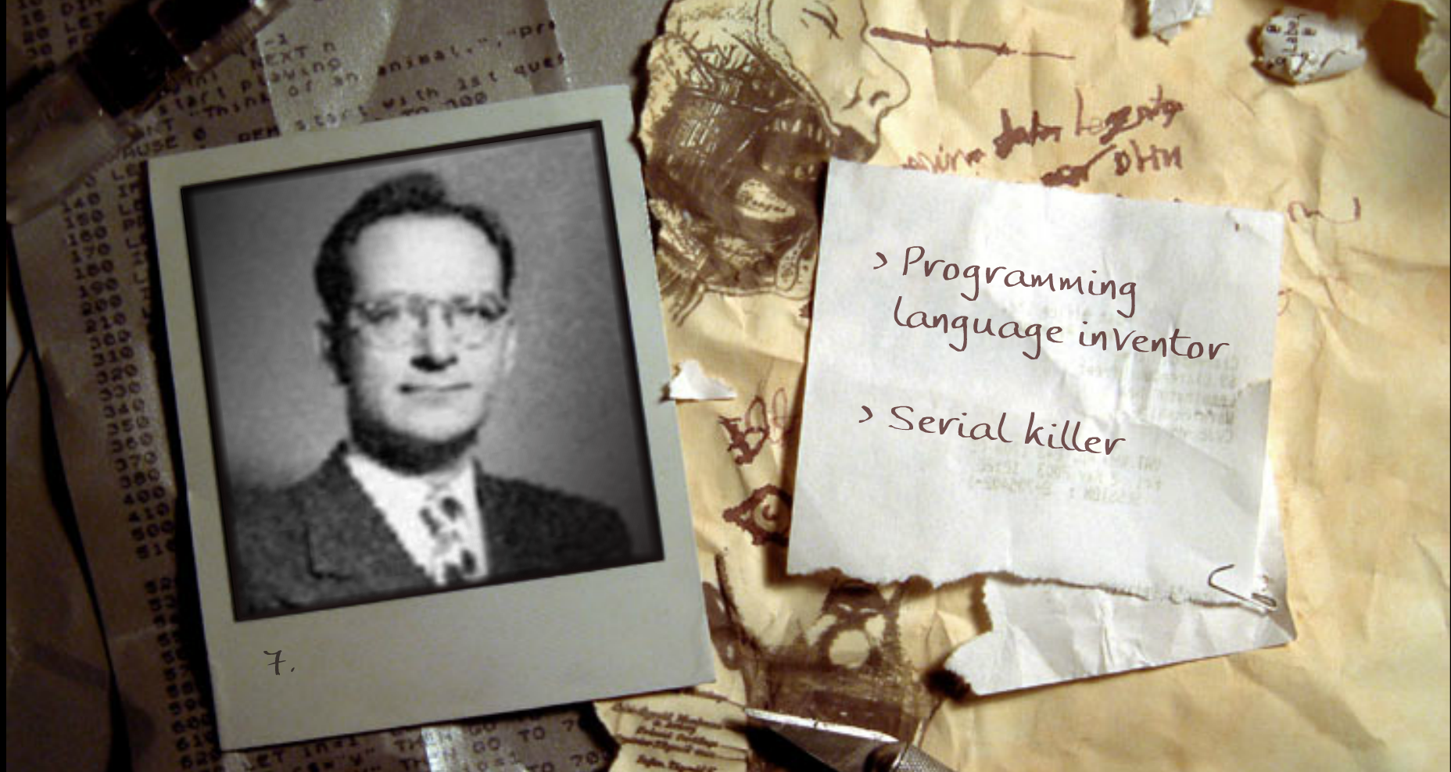
And now it’s time for your favorite game!
Notes:
John Mauchly – proposed shortcode, the first high-level programming language for an electronic computer, first run on a UNIVAC 1 Serial 1 in 1950

Slide 34
Dynamic Memory Allocation… What’s the big picture?
Often a program won’t know how much memory it needs to solve a problem until it’s actually running.
…
002000
002004
002008
002012
In these cases, C++ lets you reserve a chunk of memory on-demand, and gives you a pointer to it.
{
Your code can use the memory via the pointer.
3.14
2.718
6.022
42
1337
Reserved!
When you’re done, you then ask C++ to unreserve it!
… 011996
C++: “Ok, I’ll free it for someone else to use…”
Uses:
Dynamic allocation is used in video games, word processors, search engines, etc., etc.
“Hey C++ I need 10k slots of RAM”
void computeSomethingImportant(int count)
{
ptr = askC++ForThisMuchMemory(count);
operateOnTheMemoryAt(ptr);
tellC++WereDoneWithThisMemory(ptr);
}
ptr
C++: “Sure, I reserved slots starting at address 2000 for you!”
2000
“Hey C++ I’m done with the RAM at 2000”

Slide 35
New and Delete (For Arrays)
Let’s say we want to define an array, but we won’t know how big to make it until our program actually runs …
int main()
{
int *arr;
int size;
cin >> size;
arr = new int[size];
arr[0] = 10;
arr[2] = 75;
delete [] arr;
}
The new command can be used to allocate an arbitrary amount of memory for an array.
Your pointer variable will then be assigned the address of the new array.
So it points to the new array!
#1
How do you use it?
1. First, define a new pointer variable.
Note: Don’t forget to include brackets
delete [ ] ptr;
if you’re deleting an array…
#2
2. Then determine the size of the array you need.
#3
3. Then use the new command to reserve the memory. Your pointer gets the address of the memory.
#4
4. Now use the pointer just like it’s an array!
#5
5. Free the memory when you’re done.

Slide 36
New and Delete (For Arrays)
int main()
{
int size, *arr;
cout << “how big? ”;
cin >> size;
arr = new int[size];
arr[0] = 10;
// etc
delete [] arr;
}
The new command requires two pieces of information:
1. What type of array you want to allocate.
2. How many slots you want in your array.
Make sure that the pointer’s type
is the same as the type of array you’re creating!

Slide 37
New and Delete (For Arrays)
int main()
{
int *arr;
int size;
cin >> size;
arr = new int[size];
arr[0] = 10;
// etc
delete [] arr;
}
…
arr
00001000
00001001
00001002
00001003
00001004
00001005
00001006
00001007
00001008
…
3
size
4
* 3
= 12 bytes
3
First, the new command determines how much memory it needs for the array.

Slide 38
New and Delete (For Arrays)
int main()
{
int *arr;
int size;
cin >> size;
arr = new int[size];
arr[0] = 10;
// etc
delete [] arr;
}
…
arr
00001000
00001001
00001002
00001003
00001004
00001005
00001006
00001007
00001008
…
Yo dawg – can you reserve 12 bytes of memory for me?
Ok, ok. Mr. Operating System… can you reserve 12 bytes of memory for me?
size
4
* 3
= 12 bytes
3
00030050
00030051
00030052
00030053
00030054
...
00030060
That’s better. Ok, I found 12 bytes of free memory at address 30050.
Yo Dawg? You will address me as Mr. Operating System or NO memory for you.
Next, the new command asks the operating system to reserve that many bytes of memory.
...

Slide 39
New and Delete (For Arrays)
int main()
{
int *arr;
int size;
cin >> size;
arr = new int[size];
arr[0] = 10;
// etc
delete [] arr;
}
…
arr
00001000
00001001
00001002
00001003
00001004
00001005
00001006
00001007
00001008
…
You can now treat your pointer just like an array!
(i.e. use [ ] to index it)
You can also use the * notation if you like (instead of brackets)
30050
size
4
* 3
= 12 bytes
3
*(arr+0) = 10; // arr[0] = 10;
*(arr+1) = 20; // arr[1] = 20;
00030050
00030051
00030052
00030053
00030054
...
00030060
10
Finally, your pointer variable gets the address of the newly reserved memory.
...

Slide 40
New and Delete (For Arrays)
… not the pointer variable itself! Our pointer variable still holds the address of the previously-reserved memory slots!
int main()
{
int *arr;
int size;
cin >> size;
arr = new int[size];
arr[0] = 10;
// etc
delete [] arr;
}
…
arr
00001000
00001001
00001002
00001003
00001004
00001005
00001006
00001007
00001008
…
30050
size
Operating System – I’m done with my 12 bytes of memory at location 30050.
3
Note: When you use the delete command, you free the pointed-to memory…
CRASH!
arr[0] = 50;
}
00030050
00030051
00030052
00030053
00030054
...
00030060
10
But they’re no longer reserved for this program! So don’t try to access them or bad things will happen!
Ok.. I’ll let someone else use that memory now…
When you’re done, you use the delete command to free the array.
Usage: delete [] ptrname;
...
Notes:
Note in this example that the pointer size is 4 bytes. This assumes that we are on a 32-bit system. With most systems today, you would see the pointer occupying 8 bytes of memory because systems today are 64-bit.
64 bits, with 8 bits per byte, means 8 bytes.
So because 64 bit systems can address 2^64 memory locations, we need pointers to occupy 8 bytes.

Slide 41
New and Delete (For Non-Arrays)
We can also use new and delete to dynamically create other types of variables as well!
int main()
{
}
For instance, we can allocate an integer variable like this…
Since we didn’t allocate an array up here!
Operating System – can you reserve 4 bytes of memory for me?
// define our pointer
int *ptr;
// allocate our dynamic variable
ptr = new int;
ptr
30050
00030050
00030051
00030052
00030053
00030054
...
00030060
// use our dynamic variable
*ptr = 42;
cout << *ptr << endl;
Notice that we don’t need the [] brackets when we delete here…
Operating System – I’m done with my 4 bytes of memory at location 30050.
42
Ok.. I’ll let someone else use that memory now…
Ok.. I found 4 bytes of free memory at address 30050.
// free our dynamic variable
delete ptr;
...

Slide 42
New and Delete (For Non-Arrays)
struct Point
{
int x;
int y;
};
We can also use new and delete to dynamically create other types of variables as well!
int main()
{
}
For instance, we can allocate an integer variable like this…
Operating System – can you reserve 8 bytes of memory for me?
// define our pointer
int *ptr;
// define our pointer
Point *ptr;
Or we can allocate a struct variable like this….
// allocate our dynamic variable
ptr = new int;
// allocate our dynamic variable
ptr = new Point;
// use our dynamic variable
*ptr = 42;
cout << *ptr << endl;
// use our dynamic variable
ptr->x = 10;
(*ptr).y = 20;
ptr
30050
Operating System – I’m done with my 8 bytes of memory at location 30050.
Ok.. I’ll let someone else use that memory now…
00030050
00030052
00030054
00030056
00030058
...
00030068
x
y
10
Ok.. I found 8 bytes of free memory at address 30050.
// free our dynamic variable
delete ptr;
20
// free our dynamic variable
delete ptr;
...

Slide 43
New and Delete (For Non-Arrays)
class Nerd
{
public:
Nerd(int IQ, int zits)
{
m_myIQ = IQ;
m_myZits = zits;
}
void saySomethingNerdy()
{
cout << “C++ rocks!”;
}
…
};
We can also use new and delete to dynamically create other types of variables as well!
int main()
{
}
For instance, we can allocate an integer variable like this…
// define our pointer
Point *ptr;
// define our pointer
Nerd *ptr;
Or we can allocate a struct variable like this….
// allocate our dynamic variable
ptr = new Point;
Then calls the Nerd constructor with these parameters to initialize it!
// allocate our dynamic variable
ptr = new Nerd(150, 1000);
// use our dynamic variable
ptr->x = 10;
(*ptr).y = 20;
Or we can even allocate a class instance like this….
// use our dynamic variable
ptr->saySomethingNerdy();
This allocates enough memory for a Nerd variable...
// free our dynamic variable
delete ptr;
// free our dynamic variable
delete ptr;

Slide 44
Using new and delete in a class
Step #2:
Update our constructor so the user can pass in the size of the nerd’s array.
Step #3:
Use the new command to allocate an array of the right size. Remember its size!
class PiNerd
{
public:
PiNerd() {
for (int j=0;j< 10 ;j++)
m_pi[j] = getPiDigit(j); }
void showOff()
{
for (int j=0;j< 10 ;j++)
cout << m_pi[j] << endl; }
private:
int m_pi[10];
};
Let’s assume we’re given a function that can give us any digit of π.
Step #4:
Update our loop so we compute the first n square numbers (instead of just the first 100)
So how we might use new/delete within a class?
PiNerd(int n) {
Well, here we have a class that represents people who like to memorize π – PiNerds!
Step #6:
Add a destructor that frees the dynamic array when we’re done!
m_pi = new int[n]; // alloc array
m_n = n; // store its size!
m_n
As you can see, right now Pi Nerds can only memorize up to the first 10 digits of π.
Cool! Now we can have PiNerds of varying nerdiness!
~PiNerd() {
delete [] m_pi; // free memory
}
Step #5:
Update our loop so we print out all N numbers.
Let’s update our class so they can memorize as many digits as they like!
Step #1:
Change our fixed array to a pointer variable and add a size variable.
int main()
{
PiNerd notSoNerdy(5);
PiNerd superNerdy(100);
notSoNerdy.showOff();
superNerdy.showOff();
}
m_n
int *m_pi, m_n;

Slide 45
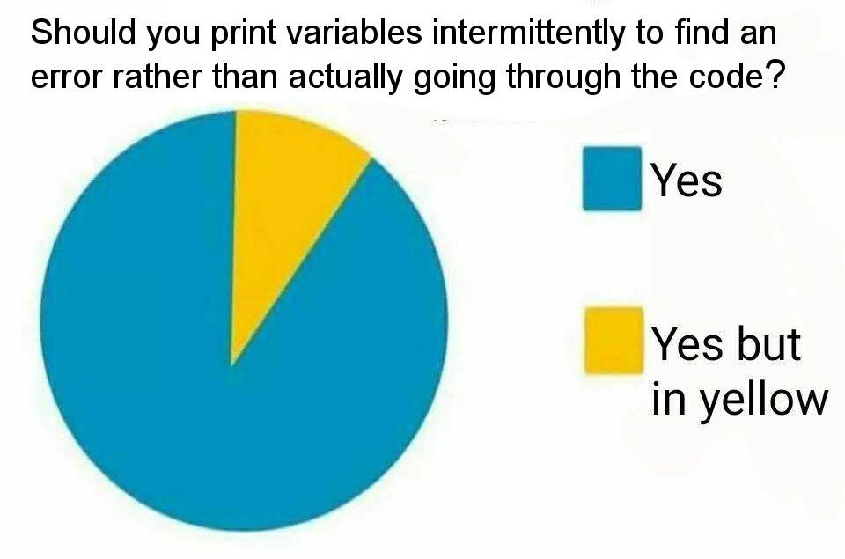
Copy Construction
* Note: This meme has nothing to do with copy construction.

Slide 46

Copy Construction… What’s the big picture?
Copy construction is when we create (construct) a new object by copying the value of an existing object.
void cloneANerd()
{
PiNerd existingNerd(4); // knows PI to 4 digits
…
PiNerd clonedNerd = existingNerd;
clonedNerd.showOff(); // prints 3.141
}
Create a new variable
By copying an existing variable
Uses:
Copy constructors are required if you want to let users make a copy of more complex class variables.
clonedNerd
existingNerd
}
To clone more complex objects, we need to create a special function to do this, called a copy constructor.
3
1
4
1
5
3
1
4
1
5

Slide 47
Copy Construction
class Circ
{
public:
float GetArea() const;
private:
float m_x, m_y, m_rad;
};
Just as we can define a constructor that initializes a new Circ variable based on (x,y) and radius values…
The parameter to our new constructor is another circle that we want to copy from!
Circ(float x, float y, float r)
{
m_x = x; m_y = y; m_rad = r;
}
We can also define a constructor that initializes a new Circ variable based on an existing Circ variable.
Circ( )
{
}
const Circ& old
That makes my head spin!
Then we just copy the member variables from the original object to the new object.
m_x = old.m_x;
m_y = old.m_y;
m_rad = old.m_rad;
In C++ lingo, this function is called a “copy constructor.”
By copying an existing circle!
Creates a new circle…
int main()
{
}
Circ a(1, 2, 3);
Circ b(a);

Slide 48
Copy Construction
But wait! Circ variable b is accessing the private variables/functions of Circ variable a – isn’t that violating C++ privacy rules?
b
class Circ
{
...
Circ( const Circ &old )
{
m_x = old.m_x;
m_y = old.m_y;
m_rad = old.m_rad;
}
...
private:
m_x m_y m_rad
}
class Circ
{
public:
float GetArea() const;
private:
float m_x, m_y, m_rad;
};
a
class Circ
{
...
Circ(float x, float y, float rad)
{
m_x = x;
m_y = y;
m_rad = rad;
}
...
private:
m_x m_y m_rad
}
Circ(float x, float y, float r)
{
m_x = x; m_y = y; m_rad = r;
}
Carey says:
That’s not a problem. Every Circ variable is allowed to “touch” every other Circ variable’s privates –
“private” protects one class from another, not one variable from another (of the same class)!
So every CSNerd object can touch every other CSNerd object’s privates.
But a CSNerd can’t touch an EENerd’s privates (for obvious reasons).
Circ( )
{
}
const Circ& old
This means:
“Initialize variable b based on the value of variable a.”
m_x = old.m_x;
m_y = old.m_y;
m_rad = old.m_rad;
3
1
2
3
1
2
int main()
{
Circ a(1,2,3);
Circ b(a);
...
}

Slide 49
Copy Construction
This one’s a bit more difficult to explain right now.
For now, just make sure you use an & here!
This is a promise that you won’t modify the old variable while constructing your new variable!
class Circ
{
public:
Circ(float x, float y, float r)
{
m_x = x; m_y = y; m_rad = r;
}
float GetArea()
{
return(3.14159*m_rad*m_rad);
}
private:
float m_x, m_y, m_rad;
};
The parameter to your copy constructor should be const!
The parameter to your copy constructor must be a reference!
Circ(
const Circ & old)
{
m_x = old.m_x;
m_y = old.m_y;
m_rad = old.m_rad;
}
old.m_x = 10; // error ‘cause of const
The type of your parameter must be the same type as the class itself!

Slide 50
Copy Construction
Oh, C++ also allows you to use a simpler syntax…
Instead of writing:
Circ b(a);
which is ugly…
You can write:
Circ b = a;
It does exactly the same thing! It defines a new variable b and then calls the copy constructor!
class Circ
{
public:
Circ(float x, float y, float r)
{
m_x = x; m_y = y; m_rad = r;
}
float GetArea()
{
return(3.14159*m_rad*m_rad);
}
private:
float m_x, m_y, m_rad;
};
Circ(
const Circ & old)
{
m_x = old.m_x;
m_y = old.m_y;
m_rad = old.m_rad;
}
int main()
{
Circ a(1,2,3);
Circ b(a);
}
Circ b = a; // same!

Slide 51
Copy Construction
class Circ
{
public:
Circ(float x, float y, float r)
{
m_x = x; m_y = y; m_rad = r;
}
float GetArea()
{
return(3.14159*m_rad*m_rad);
}
private:
float m_x, m_y, m_rad;
};
The copy constructor is not just used when you initialize a new variable from an existing one:
Circ b(a);
Circ(
const Circ & old)
{
m_x = old.m_x;
m_y = old.m_y;
m_rad = old.m_rad;
}
It’s used any time you make a new copy of an existing class variable.
Can anyone think of other times when a copy constructor would be used?

Slide 52
Copy Construction
temp
class Circ
{
...
Circ(const Circ &old)
{
m_x = old.m_x;
m_y = old.m_y;
m_rad = old.m_rad;
}
...
private:
m_x m_y m_rad
}
class Circ
{
public:
Circ(float x, float y, float r)
{
m_x = x; m_y = y; m_rad = r;
}
float GetArea()
{
return(3.14159*m_rad*m_rad);
}
private:
float m_x, m_y, m_rad;
};
void foo(Circ temp)
{
cout << “Area is: “
<< temp.GetArea();
}
int main()
{
Circ a(1,2,10);
foo(a);
}
Wait a second!
We’re creating a new variable called temp and copying the value of a into it! Hmmm!!!
Circ(
const Circ & old)
{
m_x = old.m_x;
m_y = old.m_y;
m_rad = old.m_rad;
}
a
class Circ
{
...
Circ(float x, float y, float rad)
{
m_x = x;
m_y = y;
m_rad = rad;
}
...
private:
m_x m_y m_rad
}
Here’s a simple program that passes a circle to a function… Any guesses if/when the copy constructor is called?
Now that our temp variable has been copy-constructed, it can be used normally by our foo function!
2
2
10
1
10
1

Slide 53
Copy Construction
But then why would I ever need to define my own copy constructor?
b
m_x
class Circ
{
public:
Circ(float x, float y, float r)
{
m_x = x; m_y = y; m_rad = r;
}
float GetArea()
{
return(3.14159*m_rad*m_rad);
}
private:
float m_x, m_y, m_rad;
};
m_y
If you don’t define your own copy constructor…
m_rad
a
m_x
1
1
2
3
C++ will provide a default one for you…
It just copies all of the member variables from the old instance to the new instance…
m_y
2
m_rad
3
Circ(const Circ& old)
{
m_x = old.m_x;
m_y = old.m_y;
m_rad = old.m_rad;
}
This is called a “shallow copy.”
Carey says:
“Patience, grasshopper! I’ll show you in a minute!”
int main()
{
Circ a(1,2,3);
Circ b(a);
}

Slide 54

Copy Construction
Ok – so why would we ever need to write our own Copy Constructor function?
After all, C++ shallow copies all of the member variables for us automatically if we don’t write our own!
Well, we’ll see very soon.
But first, let’s go back to our PiNerd class…

Slide 55
The PiNerd Class
When constructed, it uses new to dynamically allocate an array to hold the first N digits of π.
class PiNerd
{
public:
PiNerd(int n) {
m_n = n;
m_pi = new int[n];
for (int j=0;j<n;j++)
m_pi[j] = getPiDigit(j); }
~PiNerd(){delete []m_pi;}
void showOff()
{
for (int j=0;j<m_n;j++)
cout << m_pi[j] << endl; }
private:
int *m_pi, m_n;
};
As you recall, every PiNerd memorizes the first N digits of π.
Also recall that PiNerd uses new and delete to dynamically allocate memory for its array of N digits.
Let’s see what happens when we use this class in a simple program.
And when it is destructed, it uses delete [] to release this array.

Slide 56
Copy Construction
Operating system, can you reserve 12 bytes of memory for me?
class PiNerd
{
public:
PiNerd(int n) {
m_n = n;
m_pi = new int[n];
for (int j=0;j<n;j++)
m_pi[j] = getPiDigit(j); }
~PiNerd(){delete []m_pi;}
void showOff()
{
for (int j=0;j<m_n;j++)
cout << m_pi[j] << endl; }
private:
int *m_pi, m_n;
};
int main()
{
PiNerd ann(3);
if (...)
{
PiNerd ben = ann;
...
}
ann.showOff();
}
3
ann
3
00000800
00000804
00000808
m_n
3
1
Sure, I’ll reserve 12 bytes for you at address 800.
m_pi
800
4

Slide 57
Copy Construction
Now, watch what happens when we create our new ben variable and shallow copy ann’s member variables into it…
class PiNerd
{
public:
PiNerd(int n) {
m_n = n;
m_pi = new int[n];
for (int j=0;j<n;j++)
m_pi[j] = getPiDigit(j); }
~PiNerd(){delete []m_pi;}
void showOff()
{
for (int j=0;j<m_n;j++)
cout << m_pi[j] << endl; }
private:
int *m_pi, m_n;
};
int main()
{
PiNerd ann(3);
if (...)
{
PiNerd ben = ann;
...
}
ann.showOff();
}
Point to ann’s original copy of the array!
Both ann’s m_pi pointer…
ann
3
00000800
00000804
00000808
m_n
3
1
m_pi
800
4
And ben’s m_pi pointer…
ben
m_n
3
m_pi
800

Slide 58
Copy Construction
But that’s a problem!
Because when ben is destructed…
class PiNerd
{
public:
PiNerd(int n) {
m_n = n;
m_pi = new int[n];
for (int j=0;j<n;j++)
m_pi[j] = getPiDigit(j); }
~PiNerd(){delete []m_pi;}
void showOff()
{
for (int j=0;j<m_n;j++)
cout << m_pi[j] << endl; }
private:
int *m_pi, m_n;
};
int main()
{
PiNerd ann(3);
if (...)
{
PiNerd ben = ann;
...
}
ann.showOff();
}
Operating system, I’m done with the memory at address 800.
It ends up deleting the array that’s really owned by variable ann!
// ben's d’tor called
ann
3
00000800
00000804
00000808
m_n
3
1
m_pi
800
4
ben
m_n
3
m_pi
800

Slide 59
Copy Construction
class PiNerd
{
public:
PiNerd(int n) {
m_n = n;
m_pi = new int[n];
for (int j=0;j<n;j++)
m_pi[j] = getPiDigit(j); }
~PiNerd(){delete []m_pi;}
void showOff()
{
for (int j=0;j<m_n;j++)
cout << m_pi[j] << endl; }
private:
int *m_pi, m_n;
};
int main()
{
PiNerd ann(3);
if (...)
{
PiNerd ben = ann;
...
}
ann.showOff();
}
Because now, when we try to access ann’s array, we get garbage!!!
// ben's d’tor called
ann
?
?
?
m_n
3
m_pi
800
That’s a big problem!

Slide 60
Copy Construction
So what’s the moral of the story?
And you make a shallow copy of a class instance…
class PiNerd
{
public:
PiNerd(int n) {
m_n = n;
m_pi = new int[n];
for (int j=0;j<n;j++)
m_pi[j] = getPiDigit(j); }
~PiNerd(){delete []m_pi;}
void showOff()
{
for (int j=0;j<m_n;j++)
cout << m_pi[j] << endl; }
private:
int *m_pi, m_n;
};
int main()
{
PiNerd ann(3);
if (...)
{
PiNerd ben = ann;
...
}
ann.showOff();
}
BAD THINGS will happen when you destruct either copy...
// ben's d’tor called
Any time your class holds pointer member variables*…
* or file objects (e.g., ifstream), network sockets, etc.

Slide 61
Copy Construction
So how do we fix this?
The old variable requires three slots of memory!
For such classes, you must define your own copy constructor!
Here’s how it works for
PiNerd ben = ann;
Determine how much memory is allocated by the old variable.
Allocate the same amount of memory in the new variable.
Copy the contents of the old variable to the new variable.
3
00000800
00000804
00000808
ann
m_n
3
1
m_pi
800
4
ben
m_n
3
00000700
00000704
00000708
3
1
m_pi
700
4

Slide 62
The Copy Constructor
This means: “The new instance must have the same number of array slots as the old instance.”
class PiNerd
{
public:
PiNerd(int n) { … }
~PiNerd(){ delete[]m_pi; }
// copy constructor
void showOff() { ... }
private:
int *m_pi, m_n;
};
int main()
{
PiNerd ann(3);
if (...)
{
PiNerd ben = ann;
...
}
ann.showOff();
}
PiNerd(const PiNerd &src)
{
}
First our copy constructor must determine how much memory is required by the new instance.
m_n = src.m_n;
Let’s see how to define our copy constructor!

Slide 63
The Copy Constructor
This ensures that the new instance has its own array and doesn’t share the old instance’s array!
class PiNerd
{
public:
PiNerd(int n) { … }
~PiNerd(){ delete[]m_pi; }
// copy constructor
void showOff() { ... }
private:
int *m_pi, m_n;
};
int main()
{
PiNerd ann(3);
if (...)
{
PiNerd ben = ann;
...
}
ann.showOff();
}
PiNerd(const PiNerd &src)
{
}
m_n = src.m_n;
m_pi = new int[m_n];
Next, our copy constructor must allocate its own copy of any dynamic memory!
Let’s see how to define our copy constructor!

Slide 64
The Copy Constructor
class PiNerd
{
public:
PiNerd(int n) { … }
~PiNerd(){ delete[]m_pi; }
// copy constructor
void showOff() { ... }
private:
int *m_pi, m_n;
};
int main()
{
PiNerd ann(3);
if (...)
{
PiNerd ben = ann;
...
}
ann.showOff();
}
This ensures that the new instance has its own copy of all of the array data!
PiNerd(const PiNerd &src)
{
}
m_n = src.m_n;
m_pi = new int[m_n];
for (int j=0;j<m_n;j++)
m_pi[j] = src.m_pi[j];
Finally, we have to manually copy over the contents of the original array to our new array.
Let’s see how to define our copy constructor!

Slide 65
The Copy Constructor
class PiNerd
{
public:
PiNerd(int n) { … }
~PiNerd(){ delete[]m_pi; }
// copy constructor
PiNerd(const PiNerd &src)
{
m_n = src.m_n;
m_pi = new int[m_n];
for (int j=0;j<m_n;j++)
m_pi[j] = src.m_pi[j];
}
void showOff() { ... }
private:
int *m_pi, m_n;
};
int main()
{
PiNerd ann(3);
if (...)
{
PiNerd ben = ann;
...
}
ann.showOff();
}
Operating system, the original variable needed 12 bytes of memory, so can you reserve 12 bytes for me too?
Now I’ll copy the values from the old array into my new array.
Sure, I’ll reserve 12 bytes for you at address 900.
src
3
00000800
00000804
00000808
ann
m_n
3
1
m_pi
800
4
ben
m_n
3
00000900
00000904
00000908
3
Let’s watch our correct copy constructor work!
1
m_pi
900
4

Slide 66
The Copy Constructor
Operating System, can you free the memory at address 900 for me?
class PiNerd
{
public:
PiNerd(int n) { … }
~PiNerd(){ delete[]m_pi; }
// copy constructor
PiNerd(const PiNerd &src)
{
m_n = src.m_n;
m_pi = new int[m_n];
for (int j=0;j<m_n;j++)
m_pi[j] = src.m_pi[j];
}
void showOff() { ... }
private:
int *m_pi, m_n;
};
int main()
{
PiNerd ann(3);
if (...)
{
PiNerd ben = ann;
...
}
ann.showOff();
}
3
1
4
// ben's d’tor called
ann
3
00000800
00000804
00000808
m_n
3
No sweat, homie. Consider it freed.
1
m_pi
800
4
ben
m_n
3
00000900
00000904
00000908
3
We’re A-OK, since ann still has its own array!
1
m_pi
900
4

